Slide 1
Brew-ston, We Have a Problem I’m a Coffee Snob
by Tim Calhoun

Slide 2
About Me
Bethel College – Data Science
Oregon State University - Bachelor of Science in Agriculture
Fiserv – Client Success Partner
Married – 2 kids
Love Golf, Coffee, Breve Lattes & Tacos

Slide 3
Project Background
Coffee Quality Institute
Non-profit – improve quality of coffee and lives who produce it
Q Grader Certification
Specialty Coffee Association
Specialty Green Coffee & Cupping Standards
GitHub - Dataset

Slide 4
QCI Scoring
Scoring Metrics | Description
Aroma | Includes Fragrance of dry ground coffee & smell of coffee infused with hot water
Flavor | First impression given by first aroma & acidity to final aftertaste
Aftertaste | Length of positive flavor (taste & aroma) emanating after coffee is swallowed
Acidity | "Brightness" when favorable & "sour" when unfavorable
Body | Tactile feel of the liquid in the mouth
Balance | How Flavor, Aftertaste, Acidity & Body work together
Uniformity | Consistency of flavor of the 5 cups sampled, 2 pts cup
Clean Cup | Lack of interfering negative impressions from first ingestion to final aftertaste
Sweetness | Fullness of flavor that is pleasing, perception is result of certain carbohydrates
Cupper Points / Overall | Overall scoring aspect perceived by the individual grader
Total Cup Points | Total of all 10 scoring metrics
Green Beans
Defects
Roasting
Within 24 hours of cupping
Grinding Beans
Right before cupping
Pouring & water temp
Consistency
Q Certified = 80.0+ & defect free

Slide 5
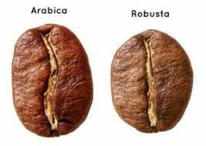
Coffee Bean Types
Arabica
Robusta
More oval in shape
Up to 75% of coffee consumed
Most common of single origins
Higher quality bean
Tastes sweeter, smoother
More round in shape
Primarily used in espresso, instant coffees & pods
Typically found in blends
Twice as much caffeine

Slide 6
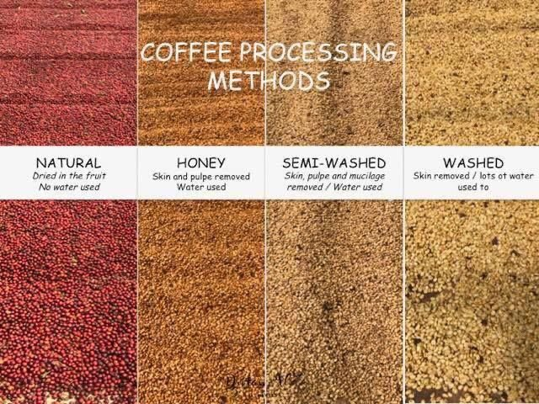
Coffee Cherry Processing Methods
Natural/Dry
Simplest – Labor intensive
Honey/Pulped Natural
Cherries de-pulped – dry w/o washing
Semi-washed/pulped
Only outer skin is removed during washing, then sun-dried
Washed/Wet
Placed in vats of water to remove skin & pulp then fermented remove mucilage
https://t.co/nTOrBYvT14" / Twitter

Slide 7
What We Bean Asking
Does country or country region and processing method affect total cup points?
Does processing method affect acidity (brightness) and aftertaste(length positive flavor) scoring?
How does Altitude affect total cup points?
What scoring categories play the biggest role in determining Cupper Points (overall scoring aspect from grader)?

Slide 8
How Data Was Used
Wrangling & Machine Learning in Python
Statistical Analysis in R
Dataset started with 1311 rows & 35 countries – ended 998 rows, 25 countries
Created Country Region – breaking countries into 5 regions
Recoded Country and Region

Slide 9
To Bean or Not to Bean
Do you think Tanzanian coffee is better than Colombian?
Will you only drink your coffee if the beans are grown at the optimal altitude?
Do you prefer coffees from Central America over coffees from Africa?
Will you only drink naturally processed beans versus washed?
If you answered Yes to any of these…stay tuned.

Slide 10
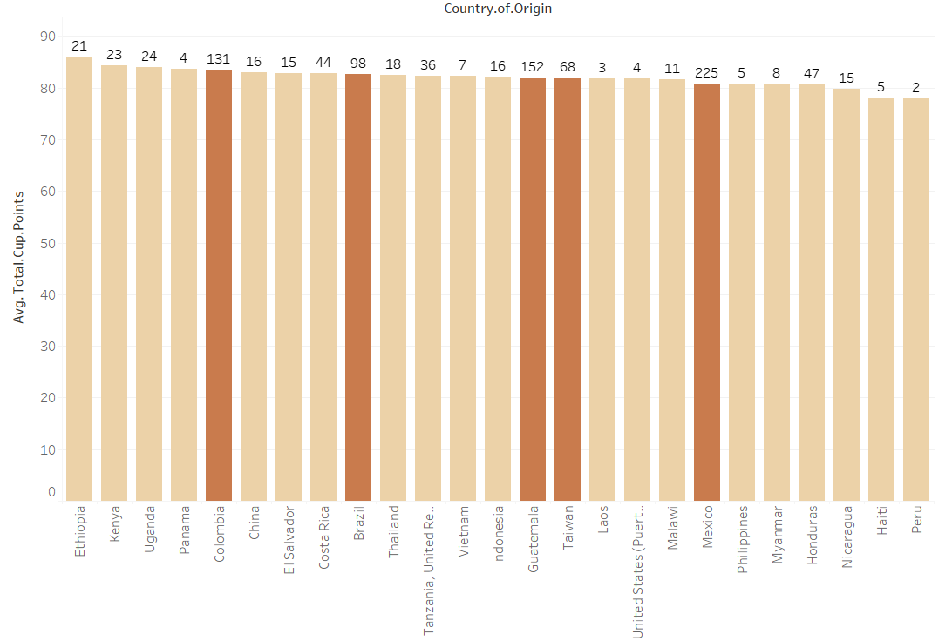
Countries Avg Total Cup Score
68%
Mexico
Guatemala
Colombia
Brazil
Taiwan

Slide 11
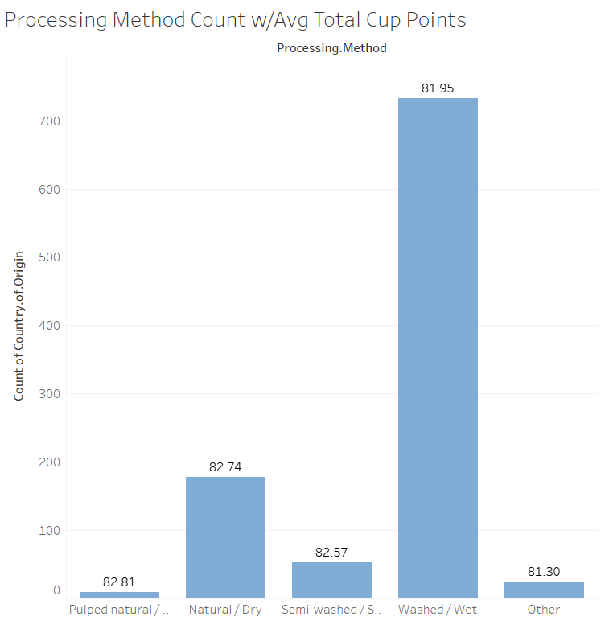
Processing Method Avg Total Cup Score
73%
Washed/Wet

Slide 12
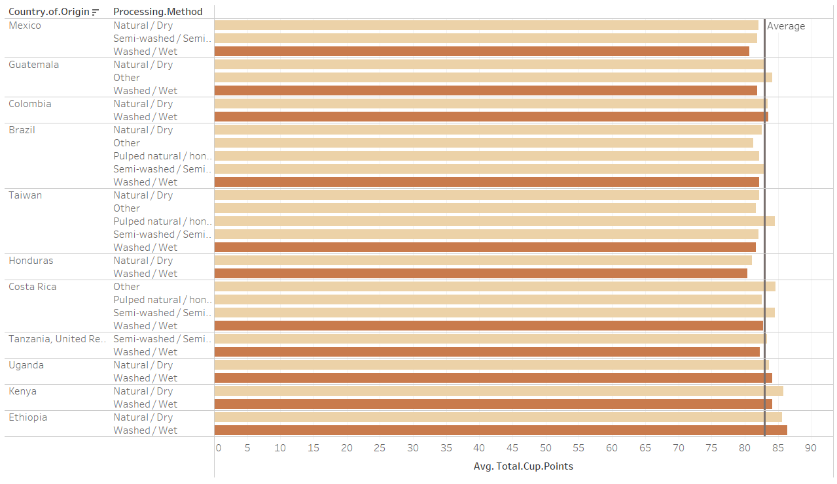
Countries and Processing Method
82.98% Avg - 11 highest count countries
82.74% Avg – Washed/Wet
Type of Processing Method has greater affect on individual countries then overall

Slide 13
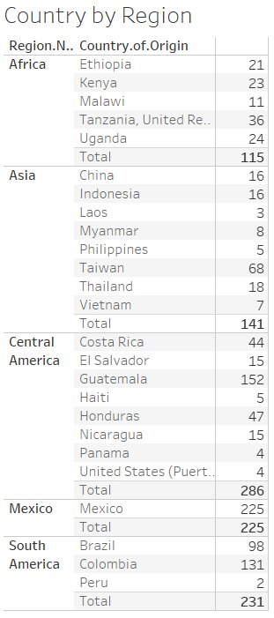
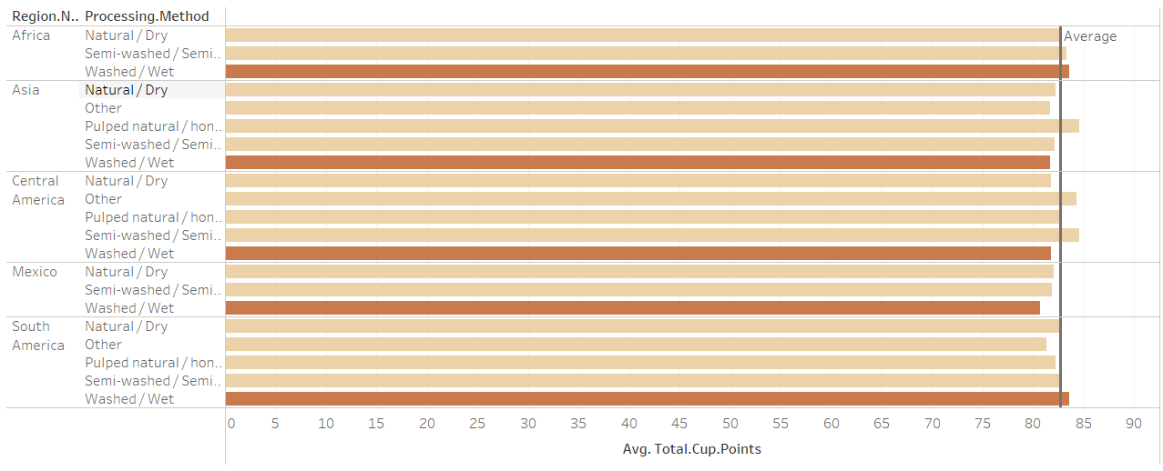
Regions and Processing Method
82.69% Avg - Overall
82.24% Avg – Washed/Wet

Slide 14
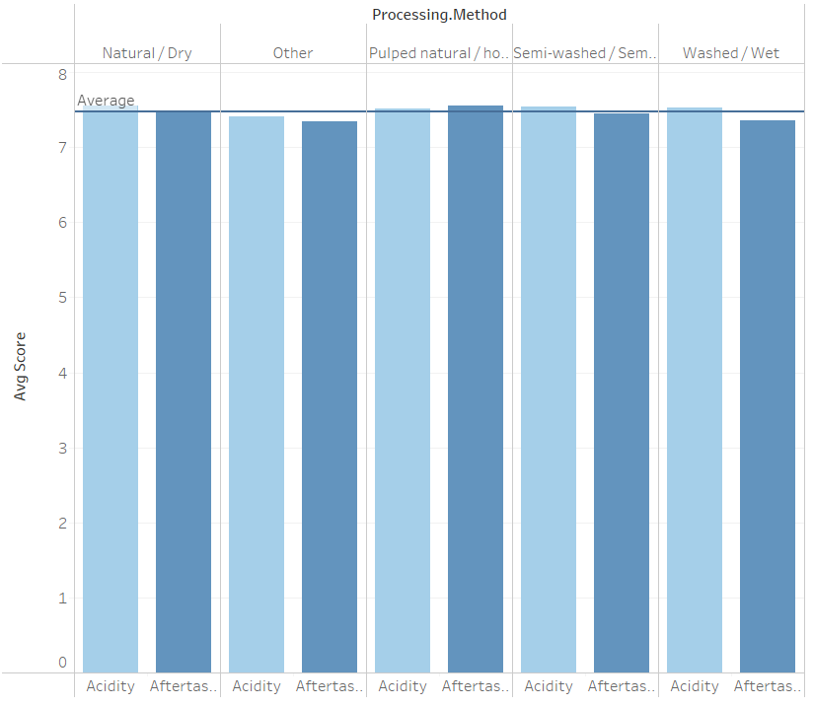
Processing Method on Acidity & Aftertaste
Method of processing cherry had little to no effect on graders scoring acidity or aftertaste
Brightness & Emanating Flavor

Slide 15
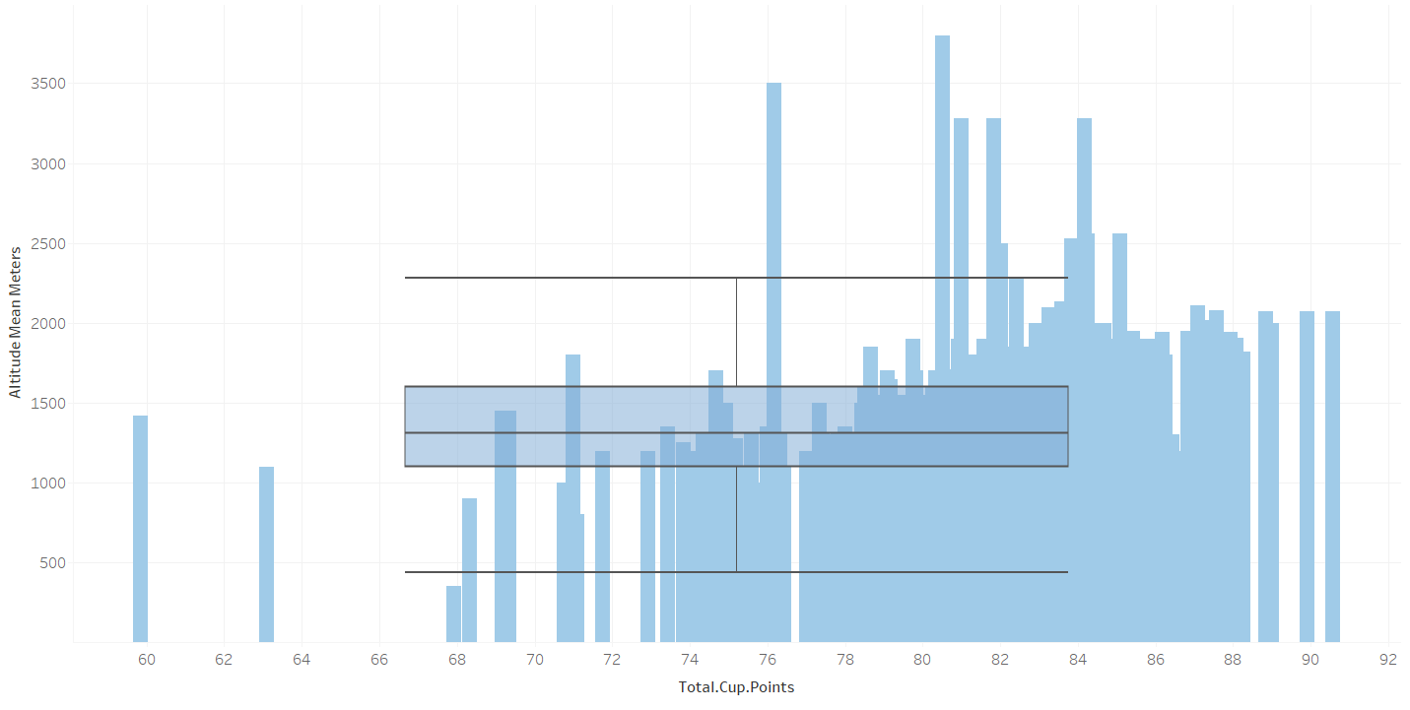
Altitude
Altitude overall impact on Total Cup Points
Explains 3% of factors
1st to 3rd quartile
11oo – 1600 meters

Slide 16
Machine Learning – Cupper Points
Best Fit Model
Flavor
Aftertaste
Balance
Acidity
Body
Clean Cup
Cupper Points
Overall aspect perceived by grader
70% accuracy

Slide 17
Recap - To Bean or Not to Bean
Do you think Tanzanian coffee is better than Colombian?
Will you only drink your coffee if the beans are grown at the optimal altitude?
Do you prefer coffees from Central America over coffees from Africa?
Will you only drink naturally processed beans versus washed?
If you answered Yes to any of these, like me…
Coffee snob you are ☺

Slide 18
Conclusion
While the majority of variables analyzed were inconclusive in determining total cup points, altitude plays a role with the majority of coffee growers between 1,100 & 1,600 meters
With 9 different scoring factors, excluding Cupper Points, going into Total Cup Points. Machine Learning could potentially calculate a true Cupper Point score to help validate scoring
CQI helps promote fine and specialty coffee beans that are void of defects, which provides the ultimate cup of coffee
Ultimately, if you are looking for specialty coffee or growers, Coffee Quality Institute is a great place to start

Slide 19
¿Questions?

Slide 20
References
Coffee Quality Institute - https://www.coffeeinstitute.org/
Specialty Coffee Association - https://sca.coffee/heritage-coffee-standards & https://sca.coffee/research/protocols-best-practices
Dataset - https://github.com/jldbc/coffee-quality-database/tree/master/data

